Slide 1
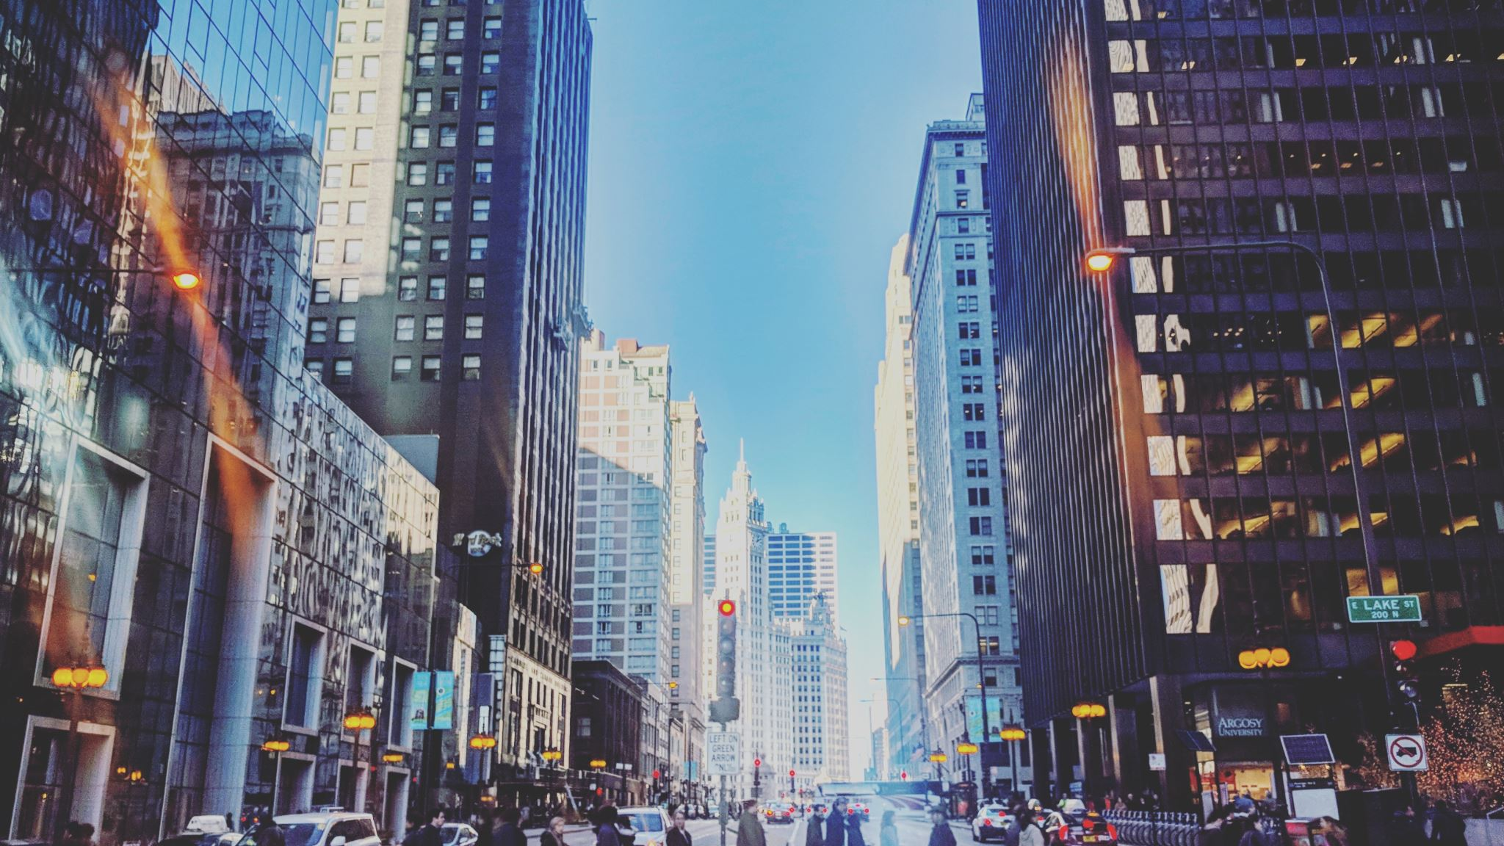
New York Fashion Runway
A Journey Through High Fashion

Slide 2
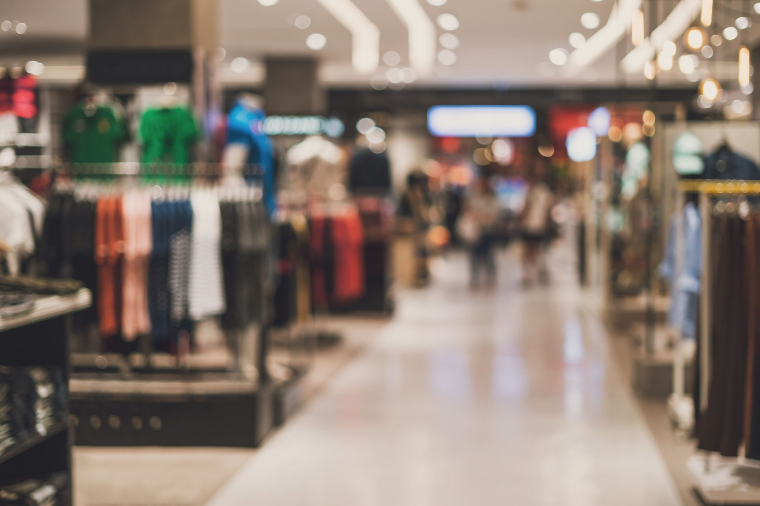
Introduction to New York Fashion Week
New York Fashion Week (NYFW) is one of the 'Big Four' fashion weeks, held annually in February and September. It showcases the latest trends and designs from world-renowned designers.

Slide 3
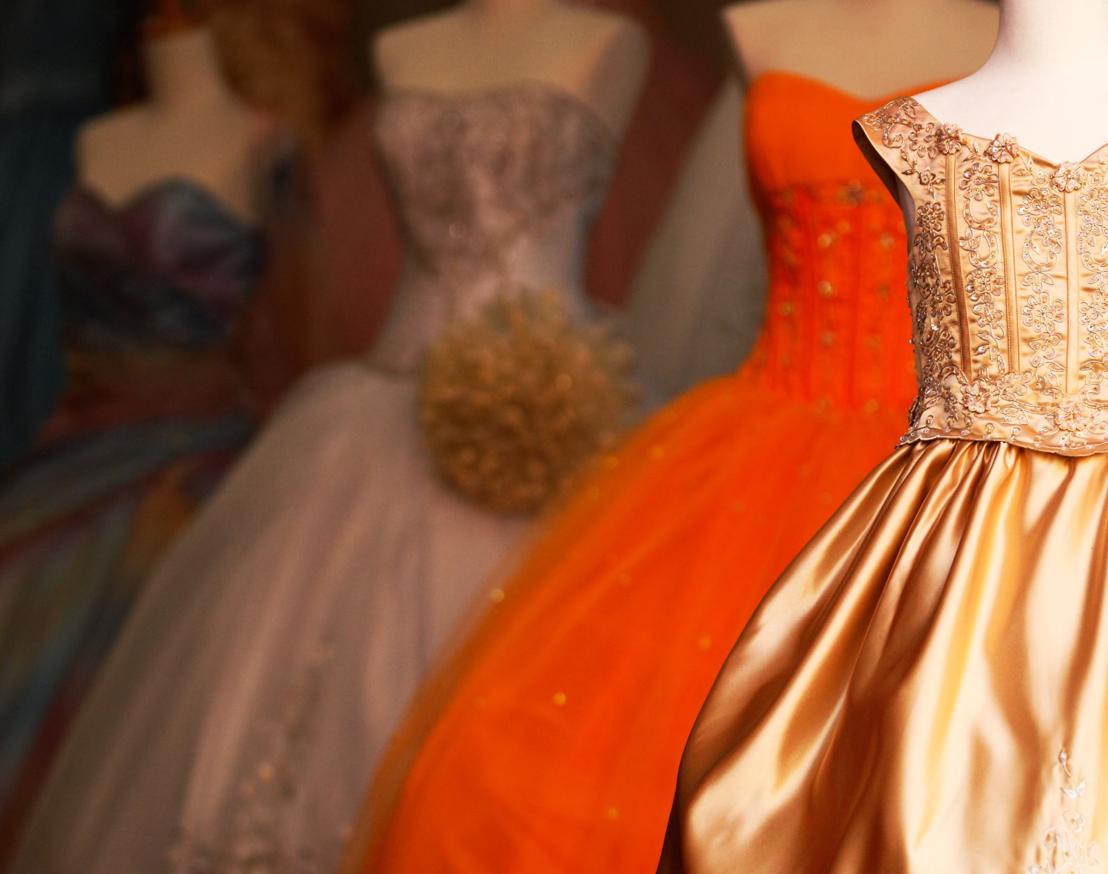
History of NYFW
Established in 1943 by Eleanor Lambert, NYFW has evolved into a global event, drawing the attention of fashion enthusiasts, designers, and media from across the world.

Slide 4
Top Designers at NYFW
New York Fashion Week features some of the most iconic designers, including Ralph Lauren, Marc Jacobs, Michael Kors, and many others who set the trends for the upcoming seasons.

Slide 5
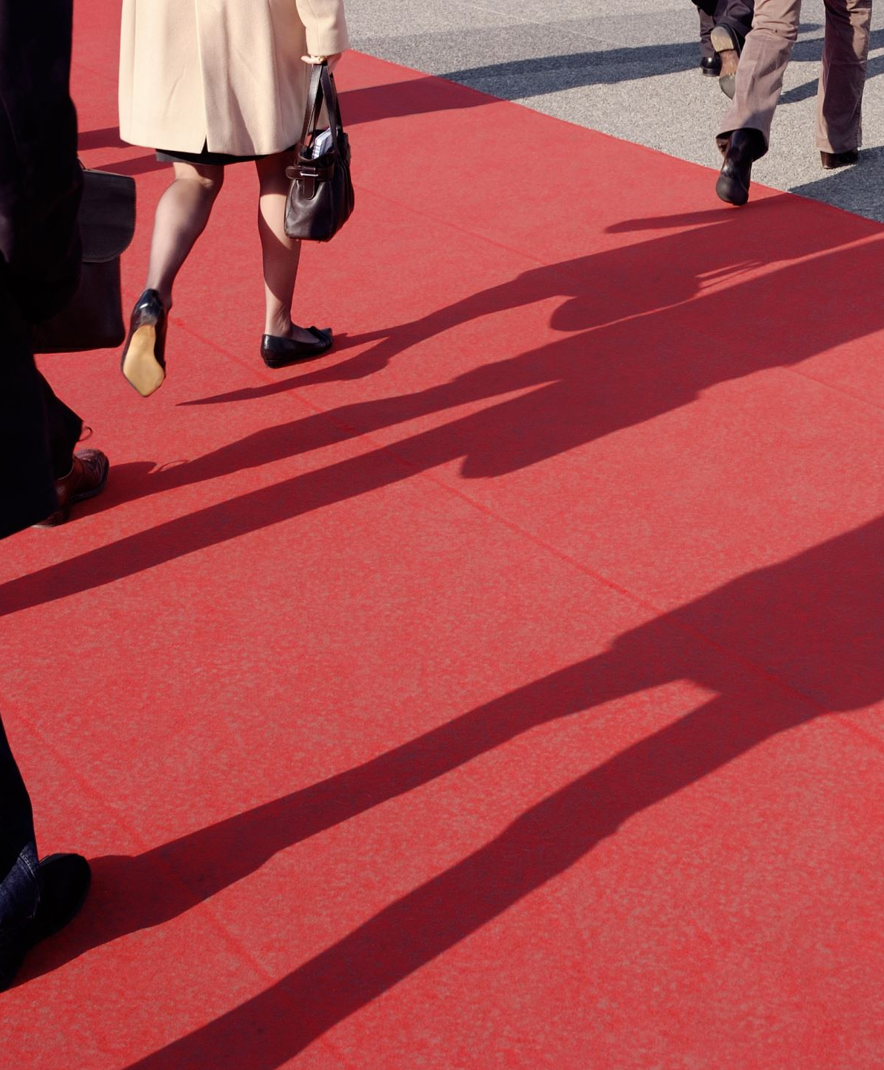
Iconic Runway Moments
NYFW has seen many unforgettable runway moments, from bold statements of individuality to groundbreaking fashion innovations that have shaped the industry.

Slide 6
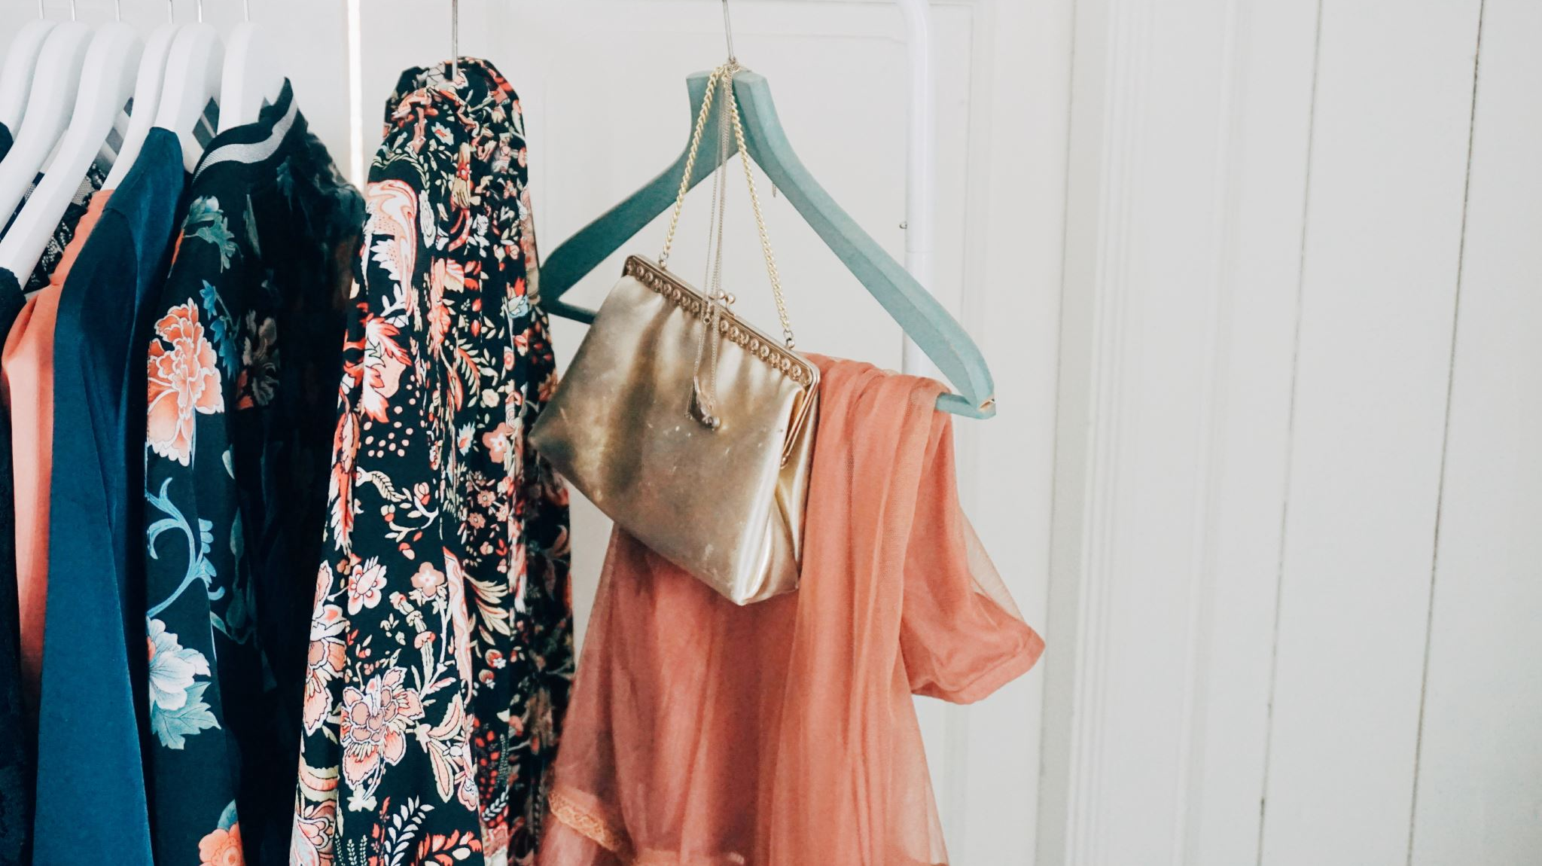
Latest Trends and Fashion Statements
Each year, NYFW brings forth new fashion trends—colors, textures, and silhouettes that define the season. This year's highlights include eco-friendly designs, bold colors, and gender-neutral clothing.

Slide 7

Celebrities and Influencers at NYFW
NYFW attracts A-list celebrities and fashion influencers who attend the shows, driving media attention and setting trends through their social media presence.

Slide 8
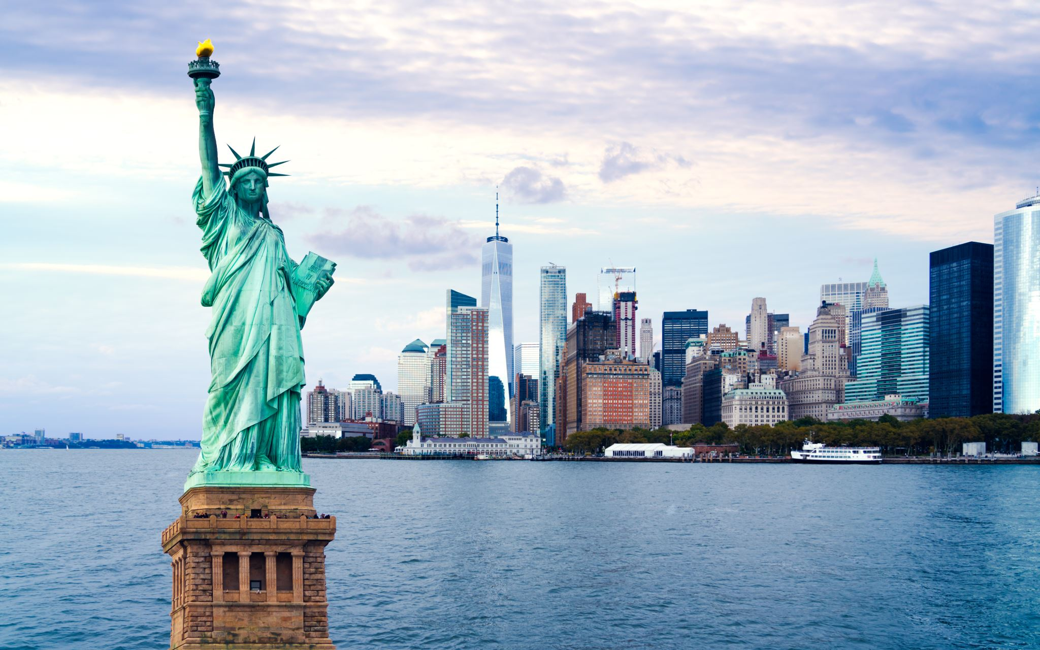
The Future of NYFW
With digital shows, sustainability at the forefront, and increasing diversity, the future of NYFW looks exciting. It's a platform that continues to push boundaries and shape the global fashion landscape.

